Slide 1
ME 165
Basic Mechanical Engineering
Lecture 10
Kinematics of Particles
Sadia Tasnim
Lecturer
Department of Mechanical Engineering, BUET

Slide 2
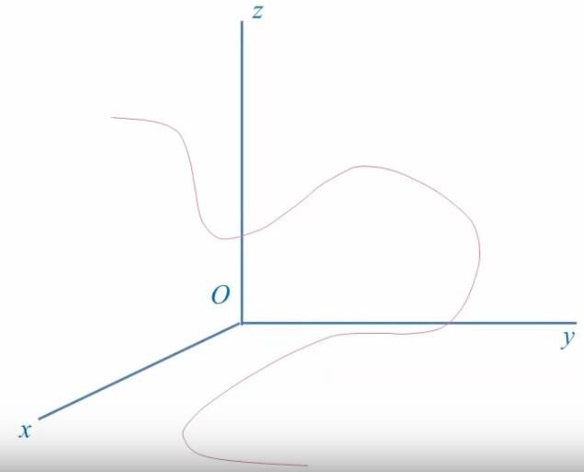


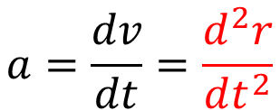
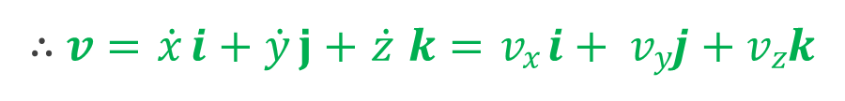
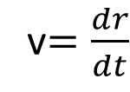

Particle Kinematics:
𝒓 = 𝑥𝒊 + 𝑦𝒋 + 𝑧𝒌
v$=\frac{dr}{dt}$
𝑧𝒌
𝑃(𝑥, 𝑦, 𝑧)
𝑃′(𝑥′, 𝑦′, 𝑧′)
∆𝒓
𝒓′
𝑦𝒋
∴ 𝒗 = $\dot{x}$ 𝒊 + $\dot{y}$ 𝐣 + $\dot{z}$ 𝒌 = 𝑣_{𝑥}𝒊 + 𝑣_{𝑦}𝒋 + 𝑣_{𝑧}𝒌
𝒓
$$a=\frac{dv}{dt}=\frac{d^{2}r}{dt^{2}}$$
𝑥𝒊
∴ 𝒂 = $\ddot{x}$ 𝒊 + $\ddot{y}$ 𝒋 + $\ddot{z}$ 𝒌 = 𝑎_{𝑥}𝒊 + 𝑎_{𝑦}𝒋 + 𝑎_{𝑧}𝒌

Slide 3
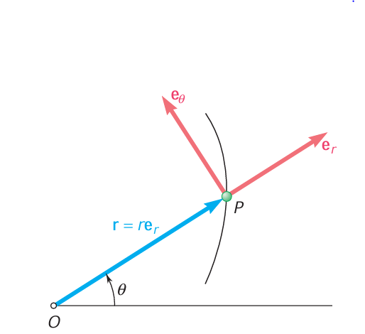
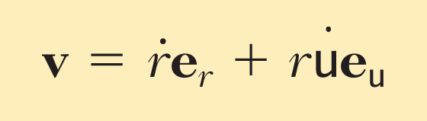
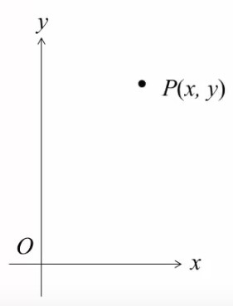

Particle Kinematics: Radial & Transverse Components
𝒋
:
𝒖_{𝒓}
𝒖
𝜽
𝑥
𝑃 (𝑟, 𝜃)
𝑟
𝑦
𝜃
Reference Line
𝒓 : Radial Coordinate
𝜽 : Transverse Coordinate
𝒊

Slide 4
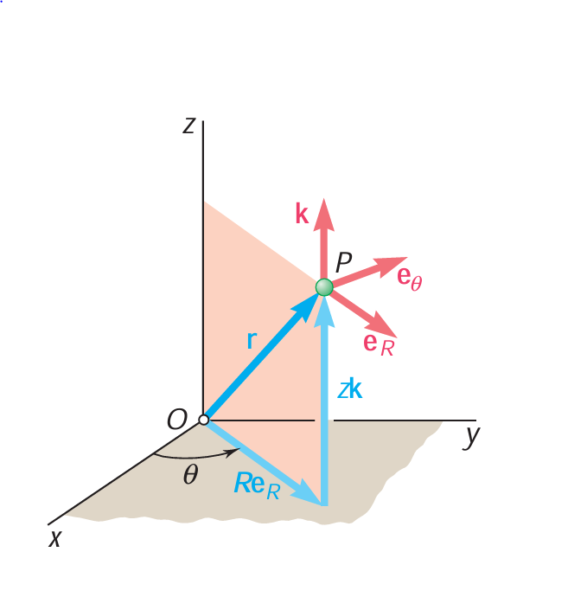
Particle Kinematics: Cylindrical Components

Slide 5
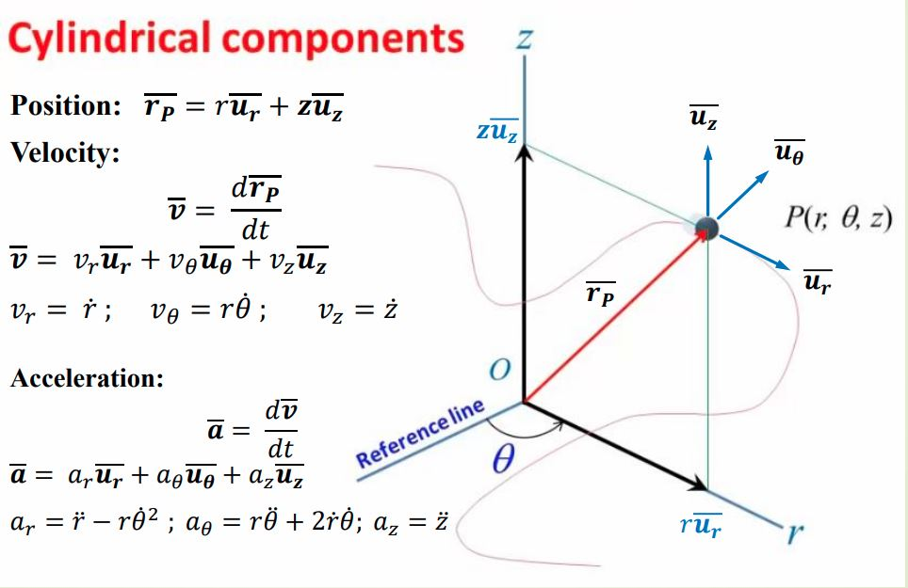

Slide 6
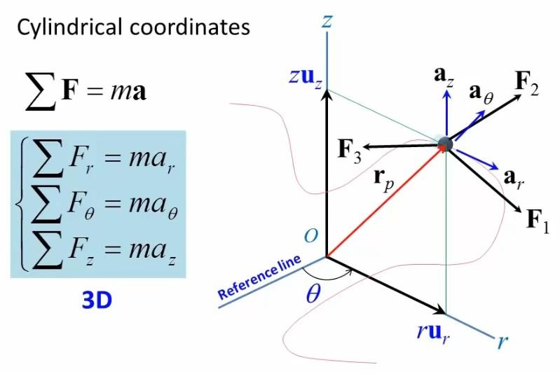
Particle Kinematics: Cylindrical Components

Slide 7
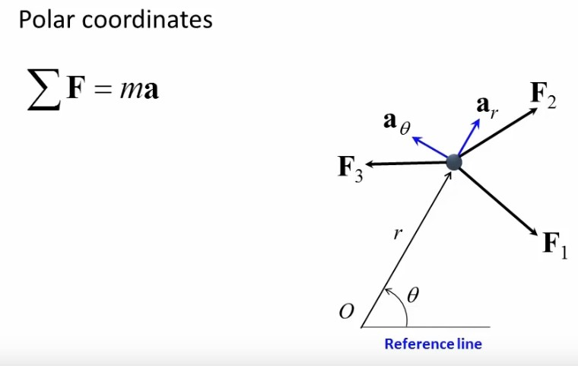
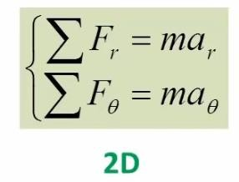
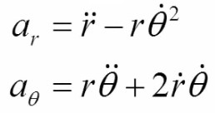
Particle Kinematics: Cylindrical Components

Slide 8
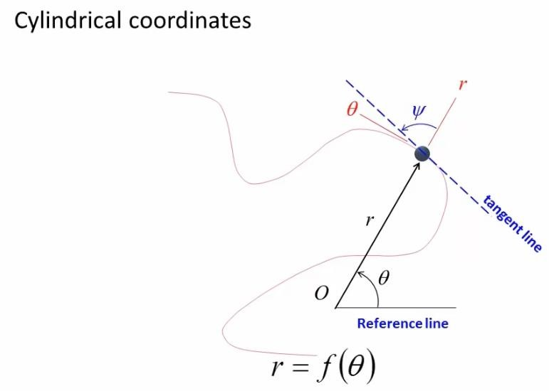
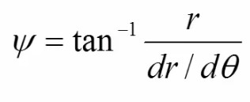
Particle Kinematics: Cylindrical Components

Slide 9
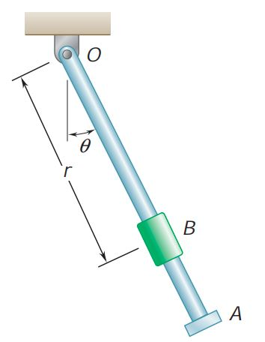
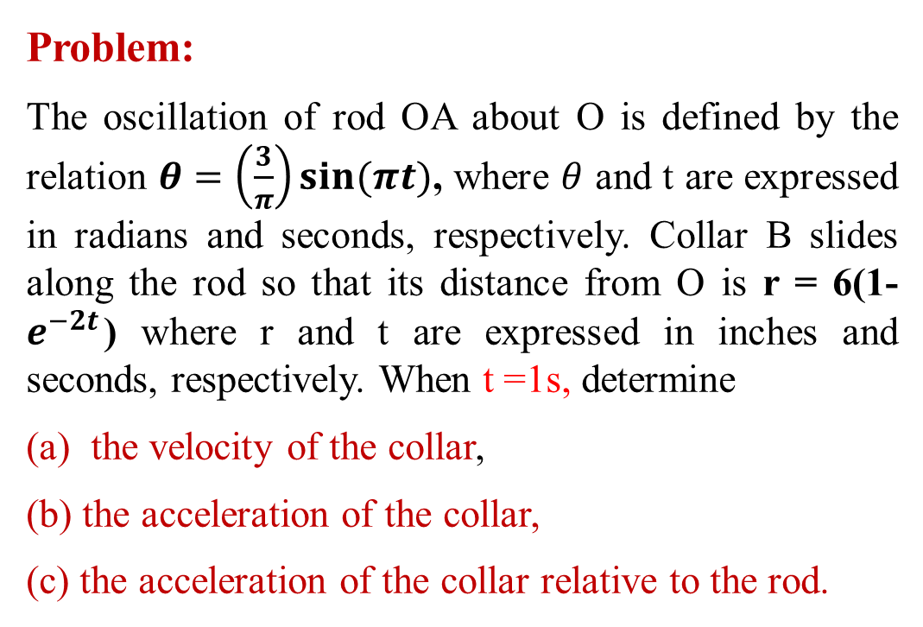
Particle Kinematics: Cylindrical Components
Problem:
The oscillation of rod OA about O is defined by the relation $θ=\left(\frac{3}{π}\right)sin⁡(πt)$, where $θ$ and t are expressed in radians and seconds, respectively. Collar B slides along the rod so that its distance from O is r = 6(1- $e^{−2t}$) where r and t are expressed in inches and seconds, respectively. When t =1s, determine
the velocity of the collar,
(b) the acceleration of the collar,
(c) the acceleration of the collar relative to the rod.

Slide 10
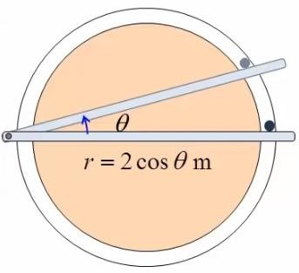
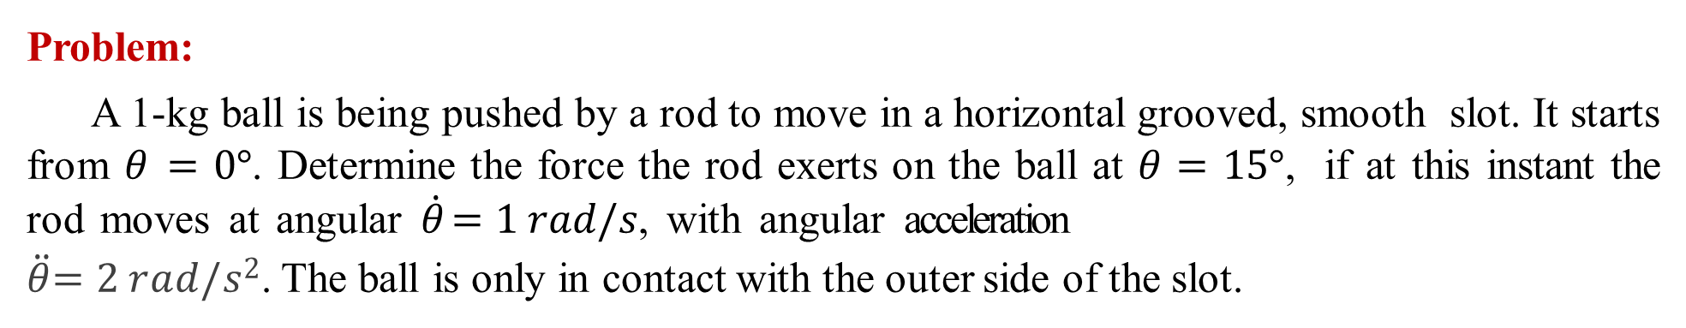
Particle Kinematics: Cylindrical Components
Problem:
A 1-kg ball is being pushed by a rod to move in a horizontal grooved, smooth slot. It starts from 𝜃 = 0°. Determine the force the rod exerts on the ball at 𝜃 = 15°, if at this instant the rod moves at angular $\dot{θ}$= 1 𝑟𝑎𝑑/𝑠, with angular acceleration
$\ddot{θ}$= 2 𝑟𝑎𝑑/𝑠². The ball is only in contact with the outer side of the slot.

Slide 11
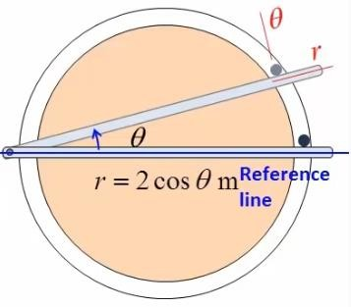
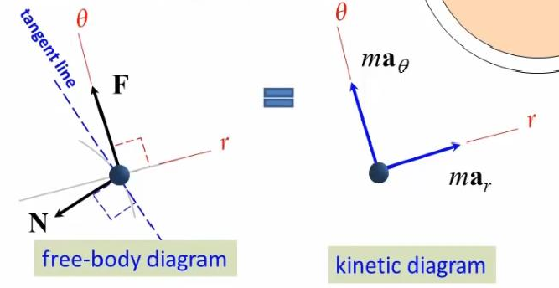

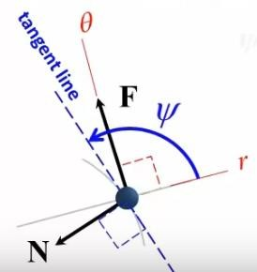

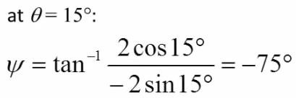
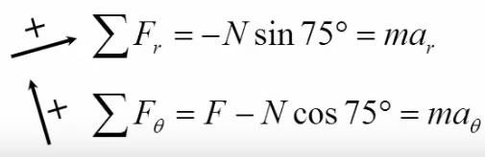
Equation of Motion : Cylindrical Components
Solution:
13
O

Slide 12



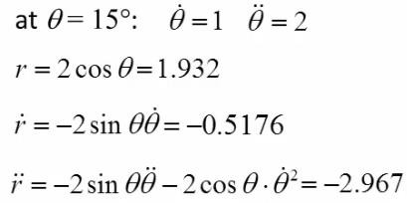
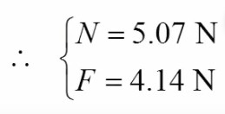

Equation of Motion : Cylindrical Components
Solution:
14
O

